Slide 1
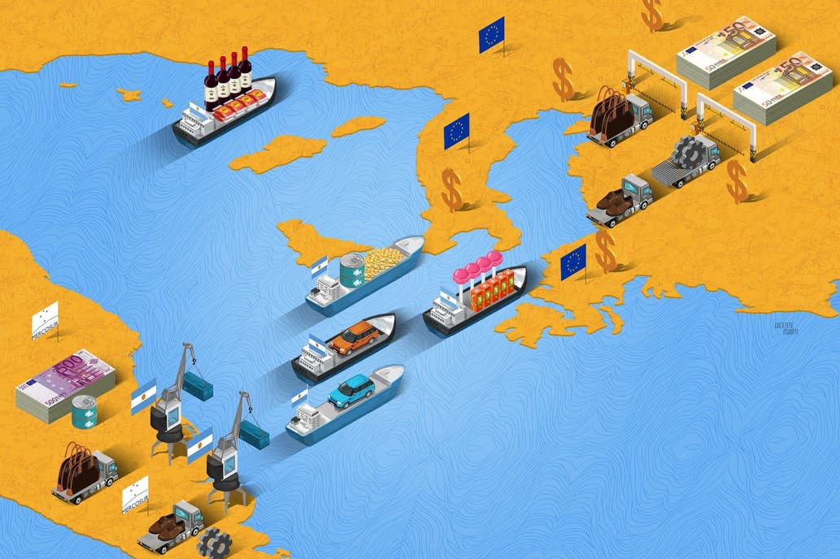
SEMESTER TOPIC
Monitoring of the performance of municipalities of the state of SP

Slide 2
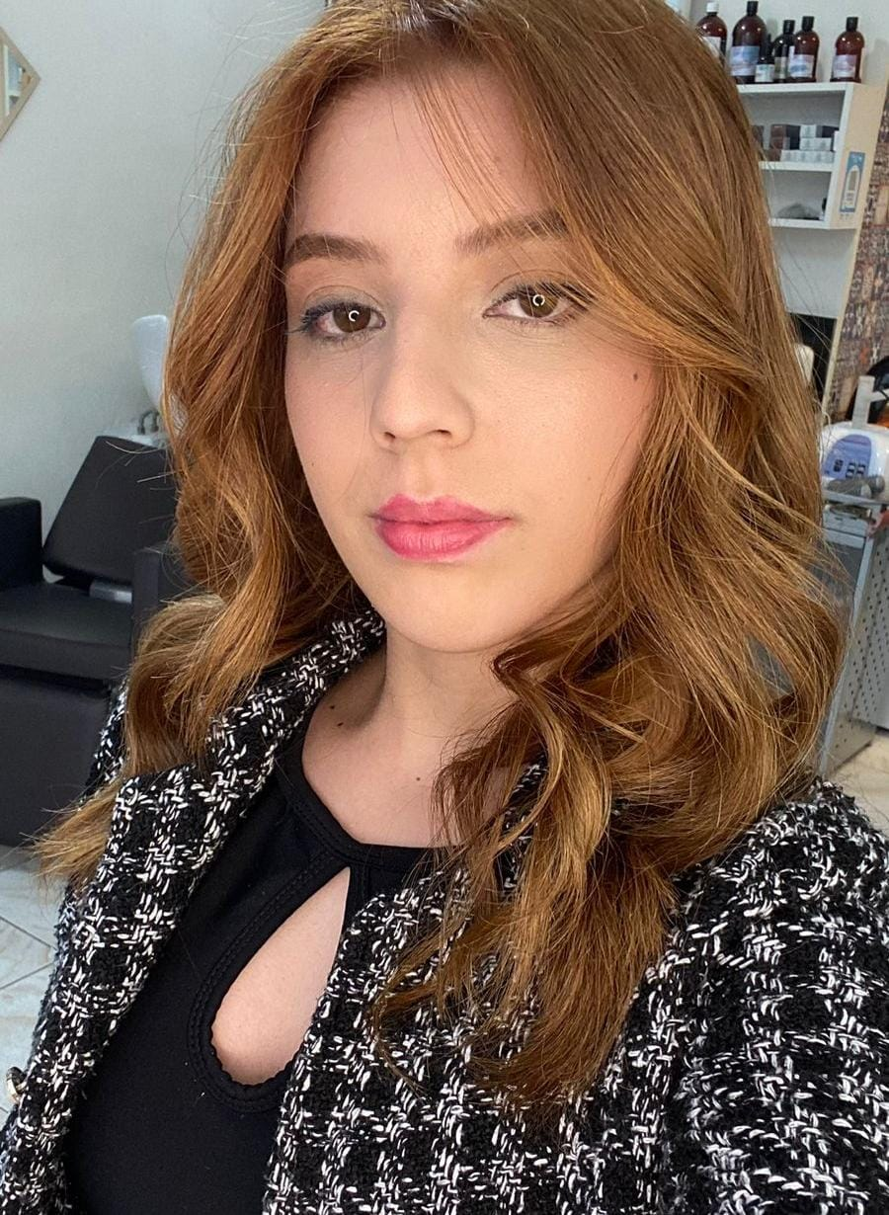
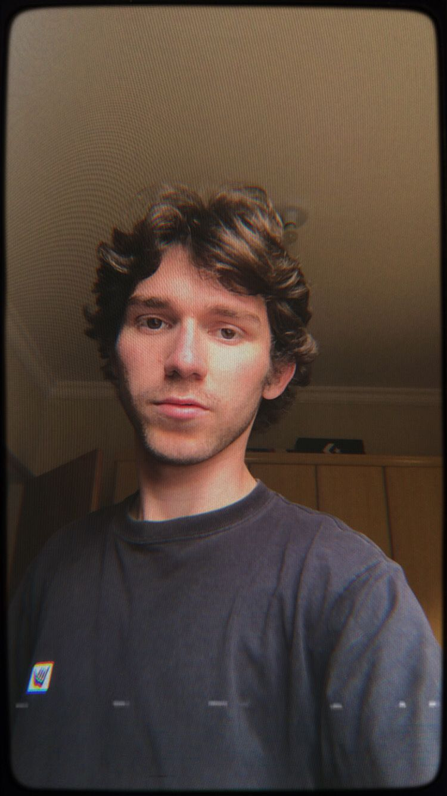
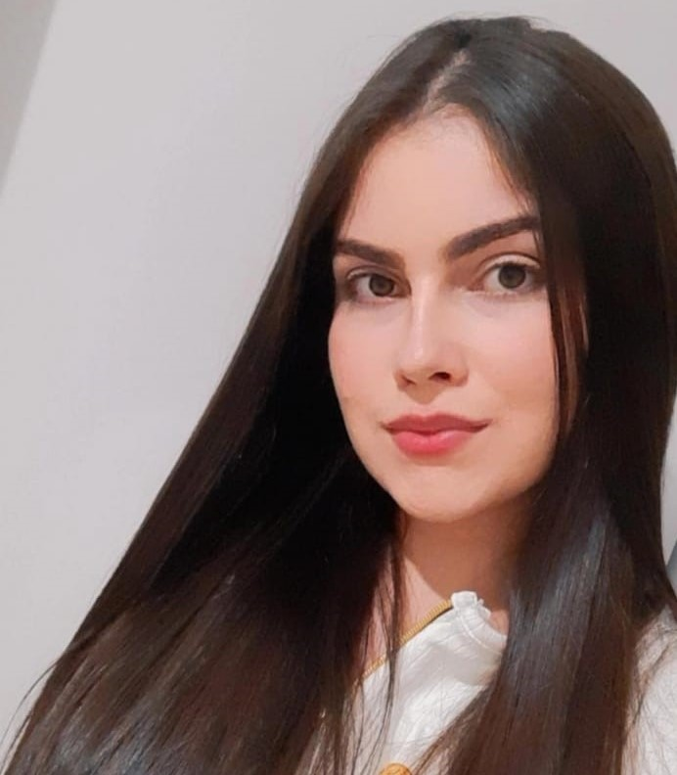
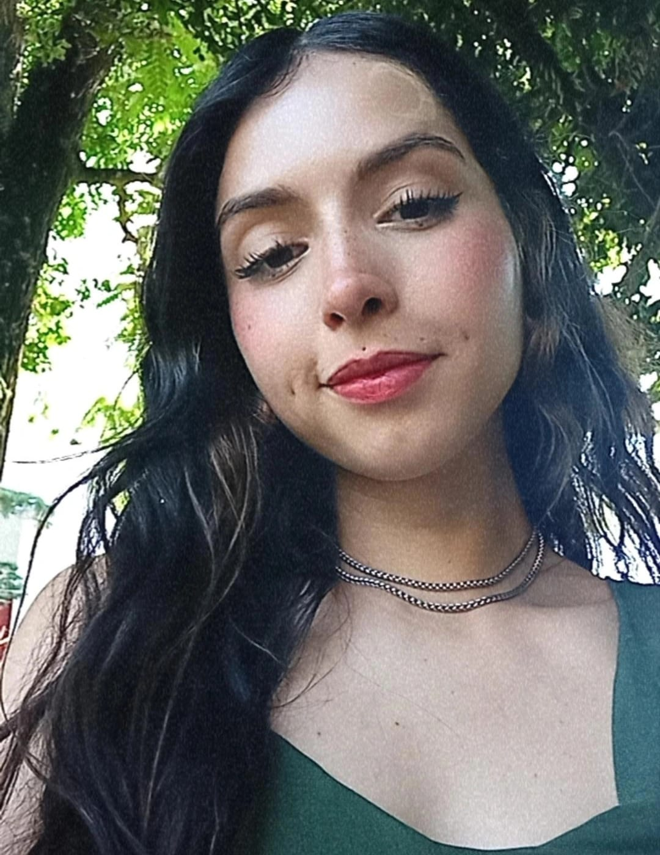
TEAM MEMBERS
-Ana Beatriz (Scrum Master)
https://www.linkedin.com/in/ana-beatriz-4026082b1?utm_source=share&utm_campaign=share_via&utm_content=profile&utm_medium=android_app
-Filipe Gabriel (Product Owner)
https://www.linkedin.com/in/filipe-gabriel-0047a131a?utm_source=share&utm_campaign=share_via&utm_content=profile&utm_medium=ios_app
-Thamires Thomaz
https://www.linkedin.com/in/thamires-thomaz-7b8409180?utm_source=share&utm_campaign=share_via&utm_content=profile&utm_medium=android_app
-Gabriela Souza
https://www.linkedin.com/in/gabriela-souza-oliveira-8b7139388?trk=contact-info

Slide 3
PROJECT OBJECTIVE
- The objective of this Project is to develop a BI platform that allows to visualize irformation on the performance of the brazilian states and municipalities of the state of São Paulo in foreign trade,based on the open data of the ministry of development,industry,trade and services.

Slide 4
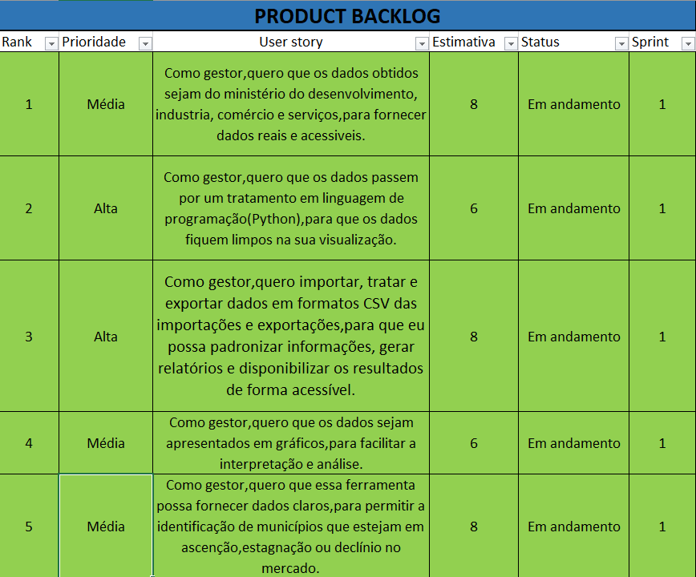
SPRINT BACKLOG

Slide 5
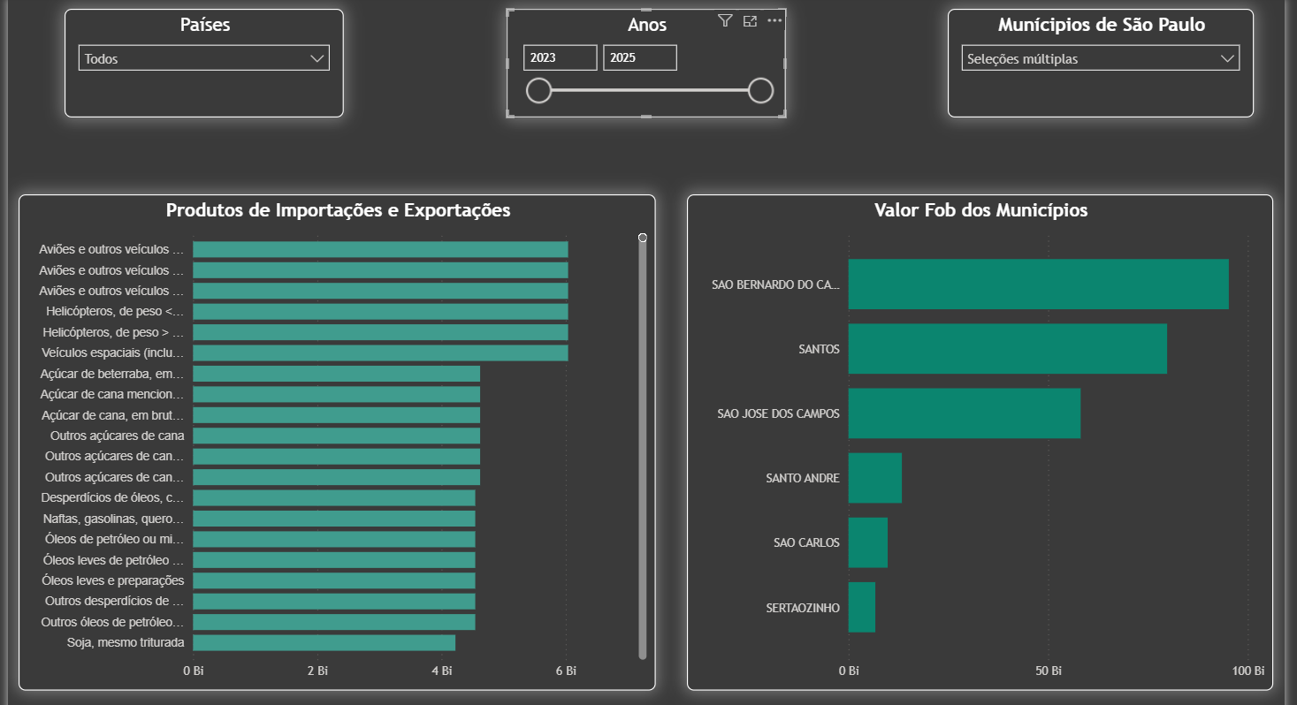

Slide 6

THANK YOU FOR YOUR ATTENTION!

